Slide 1
Chapter 5:
The List Abstract Data Type
Data Structures in Java: From Abstract Data Types to the Java Collections Framework
by Simon Gray

Slide 2
Introduction
In this chapter we apply the ideas from the previous chapters to design and implement the List interface within the JCF
Issues with inheritance, interfaces and abstract classes, list iterators, sublists are (re)examined by building a LinkedList class within the JCF
5-<number>

Slide 3
List Characteristics
A linear collection
Each element is associated with an indexable position
⇒ a list “is a kind of” collection specialized to support indexing of its elements
The first element is referred to through an attribute head and the last element through tail
The list is ordered if there is a relationship between an element and its position in the list, otherwise the list is unordered
5-<number>

Slide 4
List ADT Properties
Empty list: size is 0; head and tail reference null, a special value indicating they don’t reference a list position
Nonempty list:
  List has one element: size is 1; head and tail refer to the same position.
  List has more than one element: size is the number of elements in the list, head refers to the first element, tail refers to the last element, and these elements are in different positions.
All elements in the list must be in adjacent positions. Thus every position in the list except the head has a unique predecessor and every position in the list except the tail has a unique successor
The index of the first position is 0 and the index of the last position is size - 1; every indexed position refers to a list element
5-<number>

Slide 5
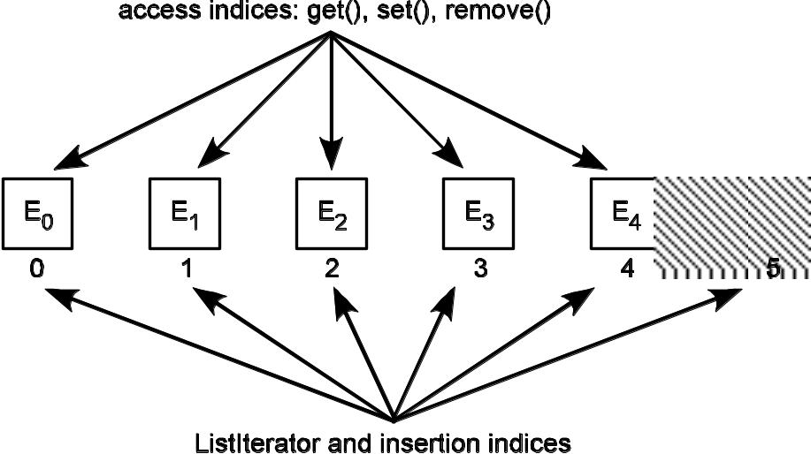
Clarifying the pre-conditions
off-by-1 opportunity
add ( int index, Type element )
pre-condition: 0 ≤ index ≤ size
responsibilities: insert element into the list at the specified location
post-condition: element is inserted in the list at position index
size is incremented by 1
tail references the element in the first position if the list was
previously empty, otherwise tail’s position is advanced by 1
head references the new element only if the list
was previously empty, otherwise head is unchanged
throws: index out of bounds exception if pre-condition is not met
returns: nothing
Where can we add an element?
5-<number>

Slide 6
Clarifying the pre-conditions
get ( int index )
pre-condition: 0 ≤ index < size
responsibilities: return the element stored at the given index position
post-condition: the list is unchanged
throws: index out of bounds exception if pre-condition is not met
returns: element at position index
off-by-1 opportunity
Where can we get an element?
5-<number>

Slide 7
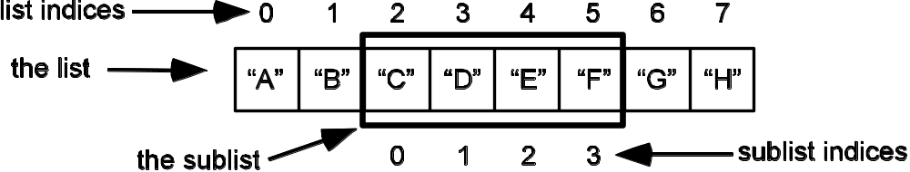
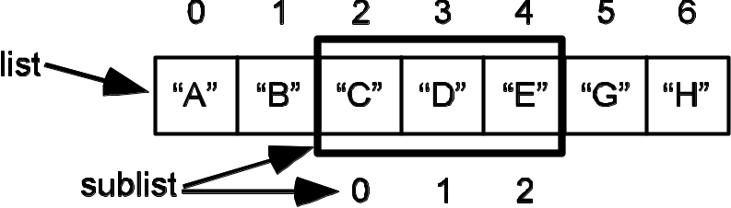
The sublist() operation
Returns a view of some part of the underlying list
The sublist has its own set of indices and supports all the List operations
Any changes made to the sublist are reflected in the underlying list
Sublist created by
List subl = list.sublist(2, 6)
Note: subl is a List
List & sublist after executing
subl.remove(3)
5-<number>

Slide 8
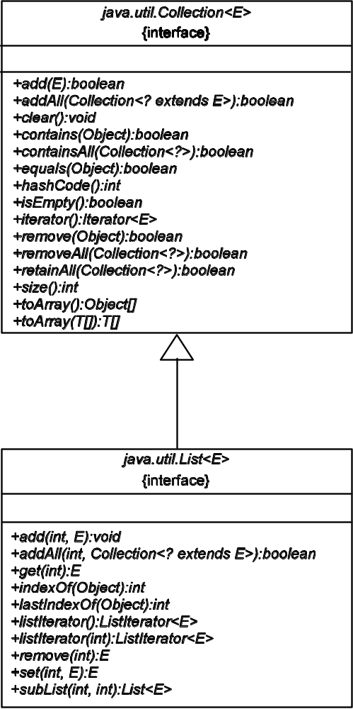
List “is a kind of” Collection
What List adds is
the ability to access elements by index ⇒ add(int index, E element)
a listIterator() method returning a ListIterator object that can begin the iteration at any position in the List and is bidirectional.
5-<number>

Slide 9
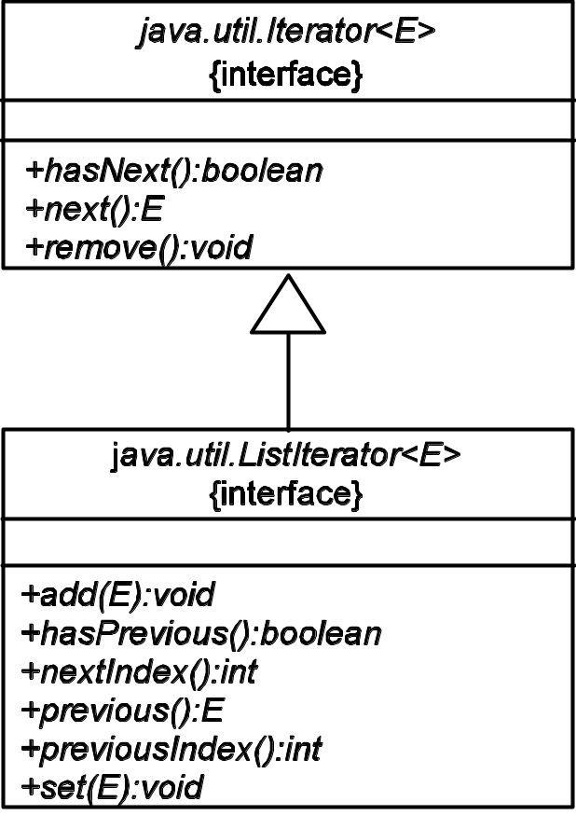
ListIterator: An Iterator for Lists!
The Iterator interface provided unidirectional traversal of a collection: next(), hasNext()
ListIterator supports bidirectional iteration: next(), hasNext(), previous(), hasPrevious()
ListIterator also supports add() and set(), as well as the remove() inherited from Iterator
5-<number>

Slide 10
The List interface
Required Methods
boolean equals(Object o) | Compares the specified object with the list for equality. (Overridden method from Object)
E get(int index) | Returns the element at the specified position in the list.
int hashCode() | Returns the hash code value for the list. (Overridden method from Object)
int indexOf(Object o) | Returns the index in this list of the first occurrence of the specified element, or -1 if the list does not contain the element.
int lastIndexOf(Object o) | Returns the index in the list of the last occurrence of the specified element, or -1 if the list does not contain the element.
ListIterator<E> listIterator() | Returns a list iterator of the elements in the list (in proper sequence).
ListIterator<E> listIterator(int index) | Returns a list iterator of the elements in the list (in proper sequence), starting at the specified position in this list.
List<E> subList(int fromIndex, int uptoIndex) | Returns a view of the portion of the list between fromIndex (inclusive) and uptoIndex (exclusive).
Optional Methods All optional methods not supported by a List implementation must throw an UnsupportedOperationException.
void add(int index, E element) |  | Inserts the specified element at the specified position in the list.
boolean addAll(int index, Collection<? extends E> c) |  | Inserts all of the elements in the specified collection into the list at the specified position.
E remove(int index) |  | Removes the element at the specified position in the list.
E set(int index, E element) |  | Replaces the element at the specified position in the list with the specified element.
5-<number>
plus stuff inherited from Collection

Slide 11
List Test Plan: Append add(int, E)
Method | Purpose | Object State | Returned Value
List<String> list = new LinkedList<String>() | Create an empty list | size = 0 head = tail = null | a LinkedList object for Strings
list.add (0, “A”) | Add “A” to the list at position 0. Tests adding to an empty list | size = 1 head = 0 tail = 0 “A” 0
list.add(1, “B”) | Add “B” to the list at position 1. Tests adding at the end of the list; index check at size() | size = 2 head = 0 tail = 1 “A” “B” 0 1
list.add(0, “B”) | Add “B” to the list at position 0. Tests adding in the front of a non-empty list | size = 3 head = 0 tail = 2 “B” “A” “B” 0 1 2
list.indexOf(“A”) | Get the index of the first occurrence of “A” in list |  | 1
list.lastIndexOf(“B”) | Get the index of the last occurrence of “B” in list |  | 2
list.get(1) | Get the element in position 1. |  | “A”
ListIterater<String> iter = list.ListIterator( list.size() ) | Get a list iterator, starting the iteration at the last element | “B” “A” “B” 0 1 2 ▲ | ListIterator object for Strings starting at list end
iter.nextIndex() | Get the index of the element that would be returned by next() |  | 3
iter.previousIndex() | Get the index of the element that would be returned by previous() |  | 2
continued on next slide
5-<number>

Slide 12
List Test Plan: Append add()
Method | Purpose | Object State | Returned Value
String s = iter.previous() | Get the previous element. | “B” “A” “B” 0 1 ▲ 2 | “B”
iter.remove() | Remove the last element returned by next()/previous(). | size = 2 head = 0 tail = 1 “B” “A” 0 1 ▲
iter.hasPrevious() | See whether there are more elements in the iteration sequence moving backward |  | true
s = iter.previous() | Get the previous element | “B” “A” 0 ▲ 1 | “A”
iter.set(“Z”) | Set the value of the last element returned by previous() | size = 2 head = 0 tail = 1 “B” “Z” 0 ▲ 1
s = iter.previous() | Get the previous element | “B” “Z” ▲ 0 1 | “B”
iter.previousIndex() | Verify an operation when there is no previous element to get |  | -1
iter.nextIndex() | Get the index of the next() element |  | 0
s = iter.next() | Get the next element and see if we can move forward once the beginning of the list is reached | “B” “Z” 0 ▲ 1 | “B”
5-<number>

Slide 13
List Test Plan: Indexed add()
Method | Purpose | Object State | Expected Result
List<String> list = new LinkedList<String>() | Create an empty list | size = 0 head = tail = null | a LinkedList object for Strings
list.add ( 0, “A” ) | Add an element at the beginning and end of list (that is, to add to an empty list!) | size = 1 head = tail = 0 “A” 0
list.indexOf( “A” ) | Verify add(int, E) |  | 0
list.add( 1, “B” ) | Add to the end of the list; upper bound test | size = 2 head = 0 tail = 1 “A” “B” 0 1
list.indexOf( “B” ) | Verify add(int, E) |  | 1
list.add( 1, “C” ) | Add to the interior of the list; interior test | size = 3 head = 0 tail = 2 “A” “C” “B” 0 1 2
list.indexOf( “C” ) | Verify add(int, E) |  | 1
list.indexOf( “B” ) | Verify an index shift after add |  | 2
list.add( 0, “Z” ) | Verify add at beginning of a non-empty list; lower bound test | size = 4 head = 0 tail = 3 “Z” “A” “C” “B” 0 1 2 3
list.indexOf( “Z” ) | Verify add(int, E) at lower bound |  | 0
5-<number>

Slide 14
List Test Plan: Verify Pre-conditions
Method | Purpose | Object State | Expected Result
List<String> list = new LinkedList<String>() | Create an empty list | size = 0 head = tail = null | a LinkedList object for Strings
list.add ( 0, “A” ) | Add an element to an empty list | size = 1 head = tail = 0 “A” 0
list.add( 1, “B” ) | Add an element to the end of the list | size = 2 head = 0 tail = 1 “A” “B” 0 1
list.set( list.size(), “C” ) | Verify that an illegal index is caught – test at upper bound + 1 |  | IndexOutOf-BoundsException
5-<number>

Slide 15
LinkedList Implementation of List
The JCF includes a hierarchy of abstract classes that mirrors its interface hierarchy
  AbstractCollection implements the Collection interface. It makes no assumption about the backing store that would be used by a concrete implementation. In Chapter 4, BasicCollection extended AbstractCollection and used an array as the backing store.
  AbstractList extends AbstractCollection and implements the List interface. AbstractList assumes a random access implementation. The concrete class ArrayList extends AbstractList and uses an array as the backing store.
  AbstractSequentialList also extends AbstractList, but assumes a sequential access data structure to represent the list. In the JCF, java.util.LinkedList is the concrete implementation of AbstractSequentialList and uses a linked list as the backing store.
5-<number>

Slide 16
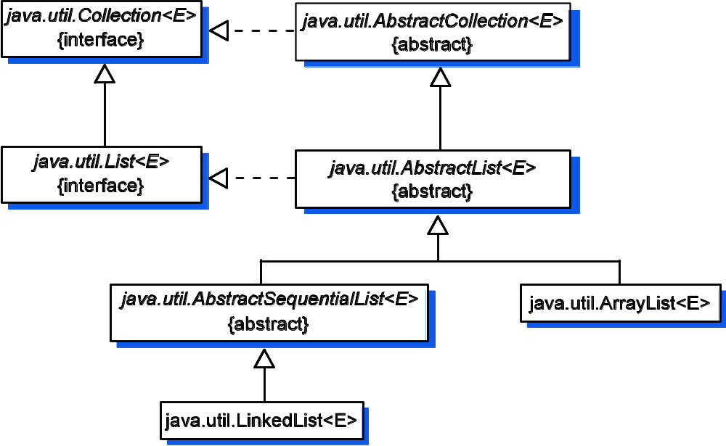
JCF interface/abstract class support for List
5-<number>

Slide 17
Implementing LinkedList within the JCF
List Methods | Implementing Classes
 | java.util.AbstractList | java.util.Abstract-SequentialList | gray.adts.- list.LinkedList
equals(Object) | overridden from Object | inherited | inherited
hashCode() | overridden from Object | inherited | inherited
indexOf(Object) | concrete | inherited | inherited
lastIndexOf(Object) | concrete | inherited | inherited
subList(int, int) | concrete | inherited | inherited
listIterator() | concrete | inherited | inherited
listIterator(int) | concrete | abstract | implement
size() | abstract | inherited | inherited
get(int) | abstract | implemented | inherited
add(int, E) | optional | overridden | inherited
add(E) | concrete | inherited | inherited
addAll(int, Collection<? extends E>) | concrete | overridden | inherited
remove(int) | optional | overridden | inherited
remove(Object) | optional | inherited | inherited
set(int, E) | optional | overridden | inherited
5-<number>

Slide 18
Implementing LinkedList: Task List
Define attributes, including deciding on the backing store for the List’s elements
Provide implementations for the only method left abstract in AbstractSequentialList:listIterator(int)
Define a class, LinkedListIterator, that implements the ListIterator interface
Provide support for the optional methods Collection.add(E), Collection.remove(E), List.add(int, E), List.addAll(int, Collection<? extends E>), List.remove(int), and List.set(int, E). A look at the previous slide tells you that this has been done for us by the abstract classes we are building on. Once the LinkedListIterator class has been implemented, these optional methods will be fully supported
5-<number>

Slide 19
Task 1: class header and attributes
Attribute | LinkedList data field
head | DLNode<E> head.succcessor()
tail | DLNode<E> tail.predecessor()
size | int size
package gray.adts.list;
import java.util.*;
import java.util.AbstractList;
public class LinkedList<E> extends AbstractSequentialList<E> {
private int size = 0; // size can never be < 0
private DLNode<E> head; // will use a dummy node
private DLNode<E> tail; // will use a dummy node
5-<number>

Slide 20
Task 2: Implement listIterator(int)
Note: In this implementation, listIterator() is held responsible for verifying that the index parameter is within the list’s bounds. Alternatively, this could have been left to the LinkeListIterator constructor. But it has to be done somewhere!
public ListIterator<E> listIterator( int index ) {
if (( index < 0 ) || ( index > size ) )
throw new IndexOutOfBoundsException("index " +
index + " is out of range: 0 to " + size);
return new LinkedListIterator<E>( index );
}
Still need to define this class
5-<number>

Slide 21
Task 3: Define ListIterator<E>
The LinkedListIterator class is fairly complicated, so we’ll create a separate Task list for it:
  Map the components of the logical model to the List implementation as a doubly linked list
  Identify the LinkedListIterator data fields
  Implement the LinkedListIterator required methods.
  Implement the LinkedListIterator optional methods
5-<number>

Slide 22
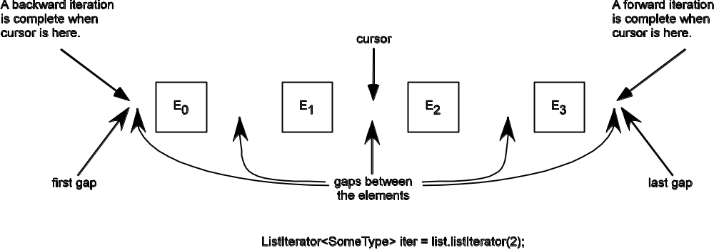
List Iterator Task 1: Map logical model to doubly linked list
A list iterator can
● move forward and backward through the iteration sequence
● begin with the cursor in any of the gaps in the iteration sequence
● provide the index of the previous or next element to be returned in the sequence
5-<number>

Slide 23
List Iterator Task 2: Identify Data Fields
public class LinkedListIterator<E> implements ListIterator<E>{
// invariant: cursor should always reference a node from
// head's successor to tail and cursor should never
// reference head.
private DLNode<E> cursor; // references node to be returned
// by next(), which is successor
// to node to be returned by
// previous()
private DLNode<E> lastNodeReturned; // last node returned
// by next()/previous()
private int nextIndex; // index of node returned by NEXT
// call to next()
private int expectedModCount; // concurrent mod check
private boolean okToRemove; // check for remove() contract
Treat previousIndex as a synthesized attribute computed using nextIndex
5-<number>

Slide 24
List Iterator Task 3: Implement Required Methods
ListIterator constructor takes an integer argument indicating the position where the iteration is to begin
  Remember, the underlying data structure is a doubly-linked list
  Linked-lists are sequential access data structures, so we want to minimize the number of links traversed
  Use the list’s bidirectionality. Start at the end closest to the starting position – at most n / 2 links will need to be traversed
5-<number>

Slide 25
List Iterator Task 3: Implement Required Methods
Listing 5.6 Implementation of ListIterator.previousIndex()
public int previousIndex() {
1. if there has been concurrent modification generate
an exception
checkForConcurrentModification();
2. if there is a predecessor in the sequence
if ( hasPrevious() )
3. return previousIndex
return nextIndex - 1;
4. else return –1
else return -1; // no more indices to examine
}
previousIndex is a synthesized
attribute computed using nextIndex
5-<number>

Slide 26
List Iterator Task 3: Implement Required Methods
Listing 5.7 Implementation of ListIterator.previous()
public E previous() {
1. if there has been concurrent modification generate an exception
checkForConcurrentModification();
2. if there is no predecessor in the sequence generate an exception
if ( ! hasPrevious() )
throw new NoSuchElementException();
3. indicate it is okay to remove an element
okToRemove = true;
4. update previousIndex attribute
nextIndex--;
5. get cursor's predecessor in the sequence
cursor = cursor.getPredecessor();
6. indicate this is the last node returned
lastNodeReturned = cursor;
7. return cursor's element
return cursor.getElement();
}
previousIndex is a synthesized
attribute computed using nextIndex
cursor references the node to be accessed by next() so needs to be “decremented” to get to the previous node
5-<number>

Slide 27
List Iterator Task 4: Implement Optional Methods ⇒ remove()
The most complicated of the optional methods
Affected by whether the node to remove was provided by previous() or next() (which is always referenced by lastNodeReturned)
Draw pictures to help understand what needs to be done!
5-<number>

Slide 28
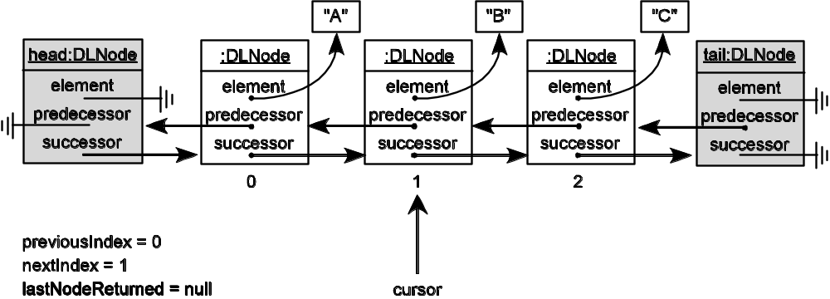
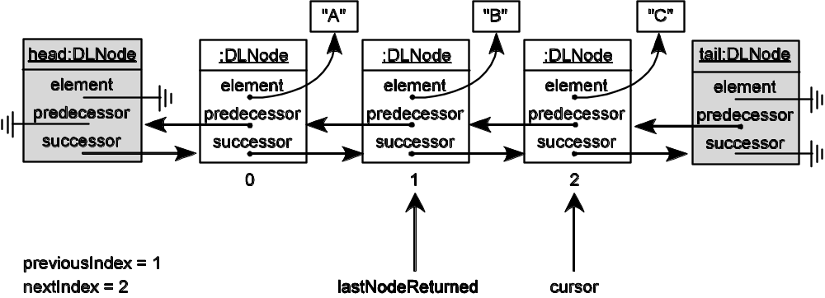
List Iterator Task 4: Implement Optional Methods: remove() element provided by next()
State before call to
iter.next()
(b) Case 1: state produced by
Object o = iter.next()
5-<number>

Slide 29
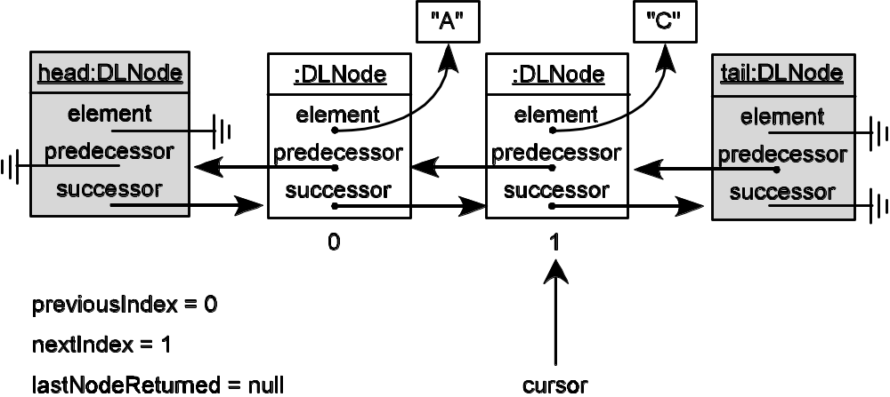
List Iterator Task 4: Implement Optional Methods: remove() element provided by next()
(c) Case 1: state after
iter.remove()
Note:
value of lastNodeReturned
position of cursor after the removal
5-<number>

Slide 30
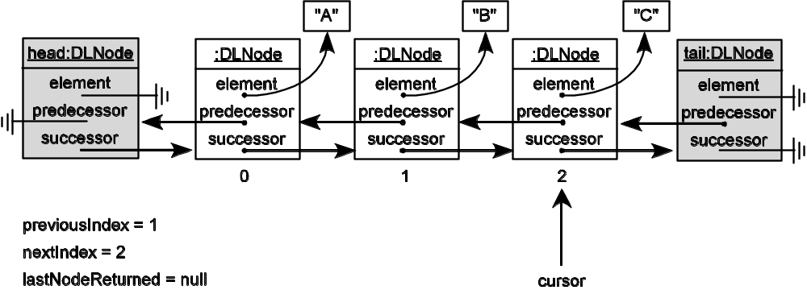
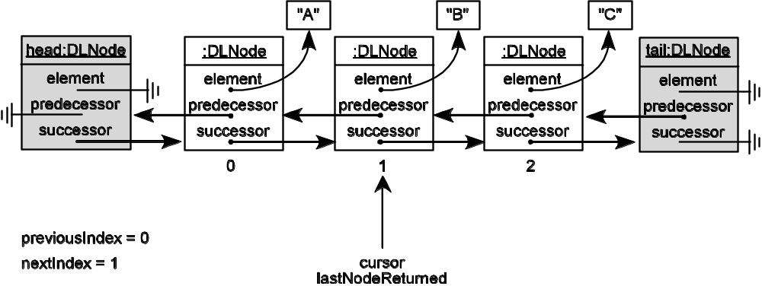
List Iterator Task 4: Implement Optional Methods: remove() element provided by previous()
State before call to
iter.previous()
(b) Case 2: state produced by
Object o = iter.previous()
5-<number>

Slide 31
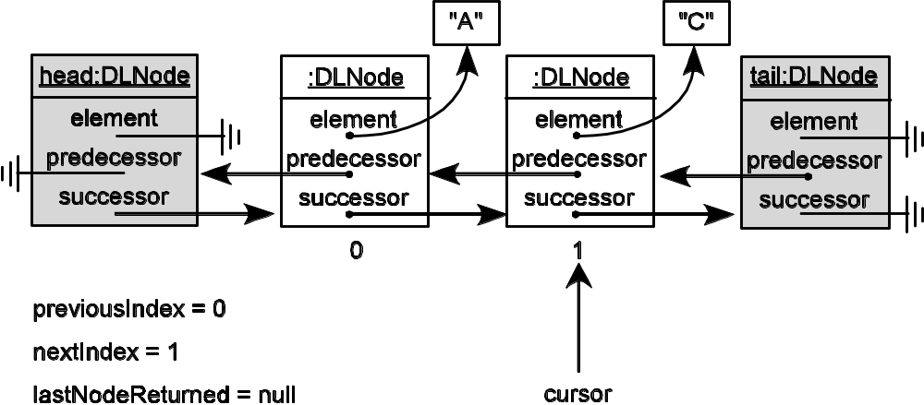
List Iterator Task 4: Implement Optional Methods: remove() element provided by previous()
(c) Case 2: state after
iter.remove()
Note:
value of lastNodeReturned
position of cursor after the removal
5-<number>

Slide 32
Analysis: Space Complexity
Array-based implementation: Θ(m) where m is the capacity of the list
Linked-list implementation: space overhead is due to the cost of the two link fields, so is
Θ( n • 2 • size of a reference) where n is the number of nodes in the list
5-<number>

Slide 33
Analysis: Time Complexity
Operation | ArrayList | LinkedList
add()/remove()
at head | Θ(n) | Ο(1)
at tail | Ο(1) | Ο(1)
in interior | Ο(n) | Ο(n)
contains()/indexOf() | Ο(n) | Ο(n)
get(int) | Ο(1) | Ο(n)
listIterator(int) | Ο(1) | Ο(n)
size()/clear() | Ο(1) | Ο(1)
Time complexity for the List ADT operations for the
array and linked list implementations
5-<number>

Slide 34
Measurement
n | Time per Iteration Array Linked List
20,000 40,000 60,000 80,000 100,000 | 02.44 04.80 07.33 10.40 13.70 | 05.50 11.00 16.40 23.00 27.60
Comparison of traversals of
ArrayList and LinkedList (in seconds)
5-<number>

